Slide 1

Visión por Computador
Domingo Mery
Departamento de Ciencia de la Computación
Escuela de Ingeniería
Universidad Católica de Chile
Explicabilidad

Slide 2
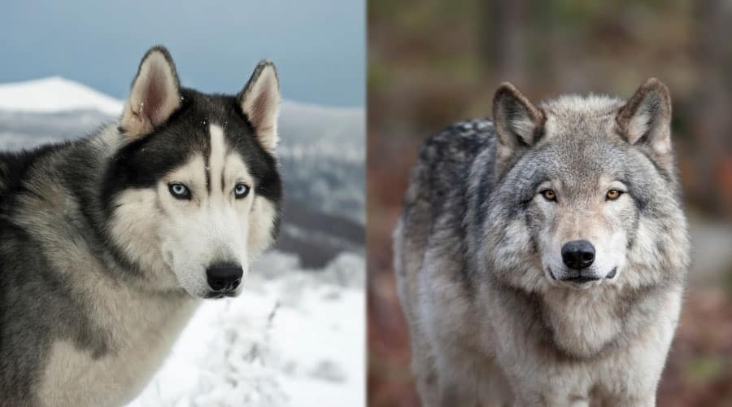
HUSKY
WOLF

Slide 3
TRAINING DATA SET

Slide 4
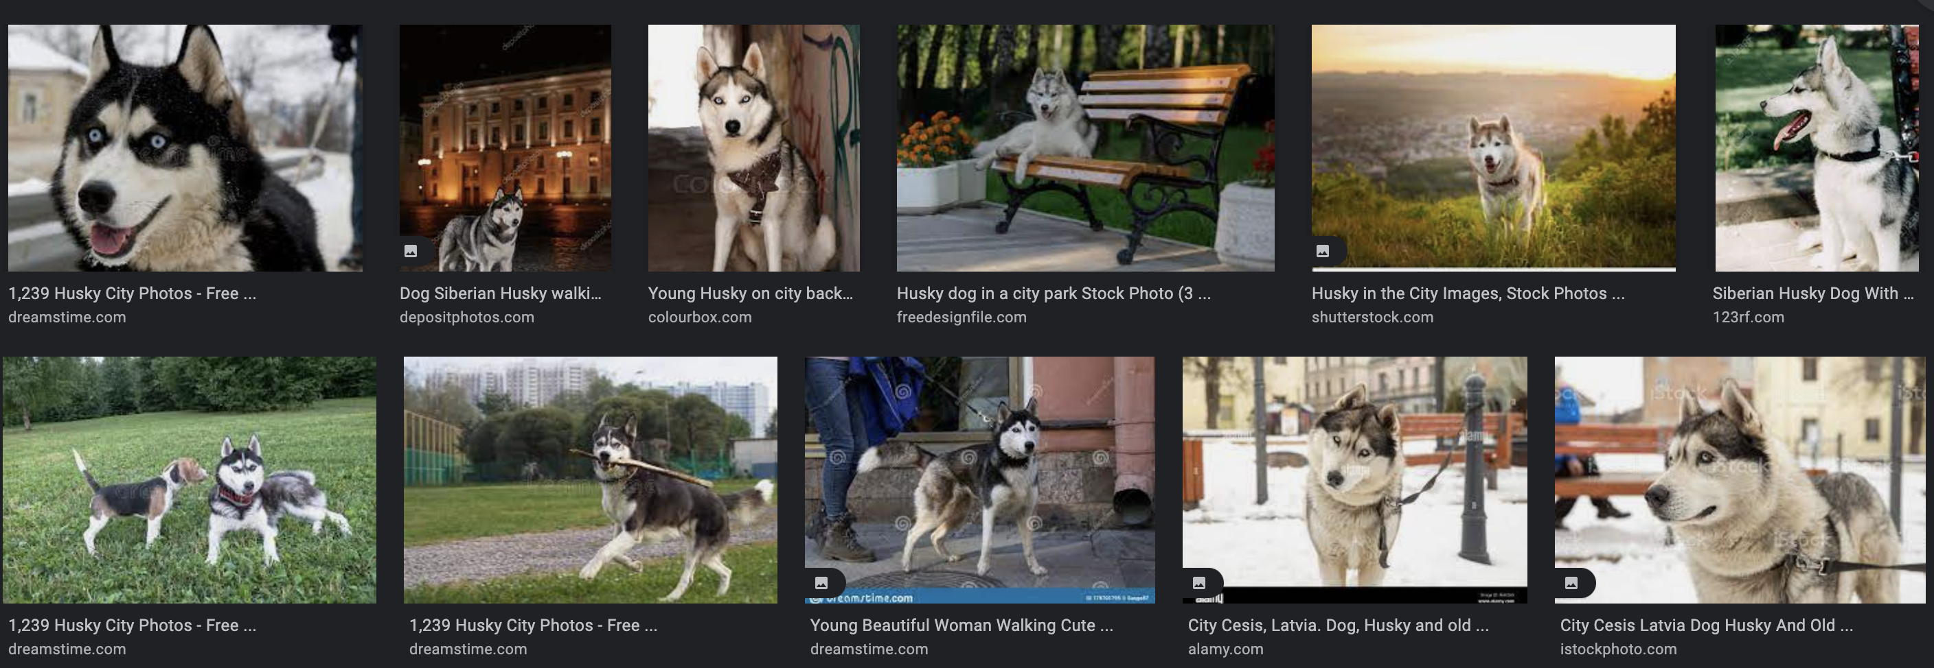
HUSKY

Slide 5
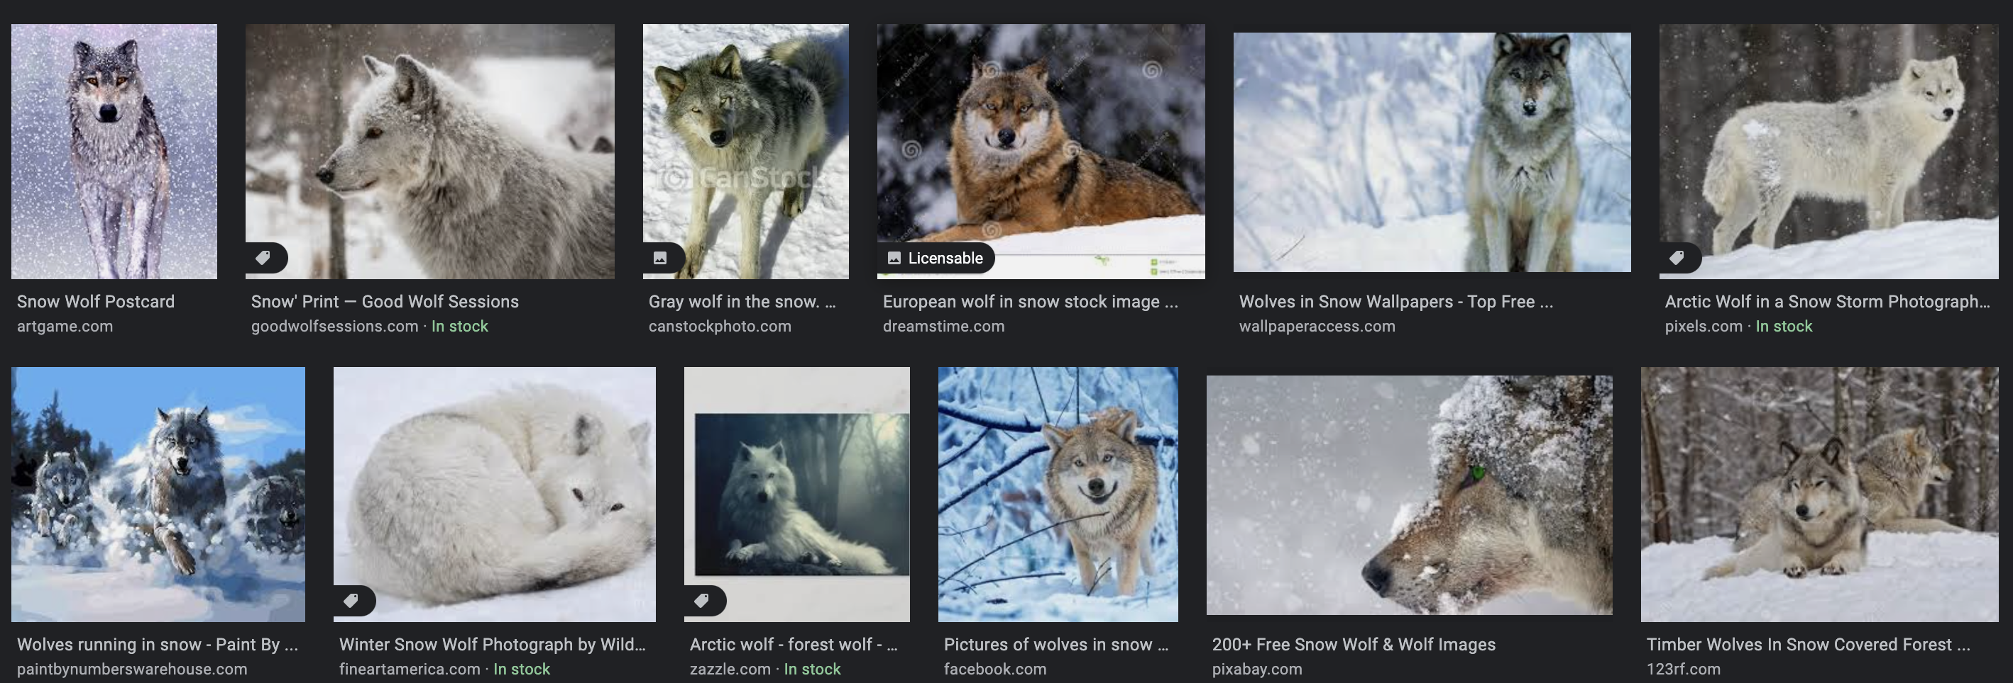
WOLF

Slide 6
TESTING

Slide 7
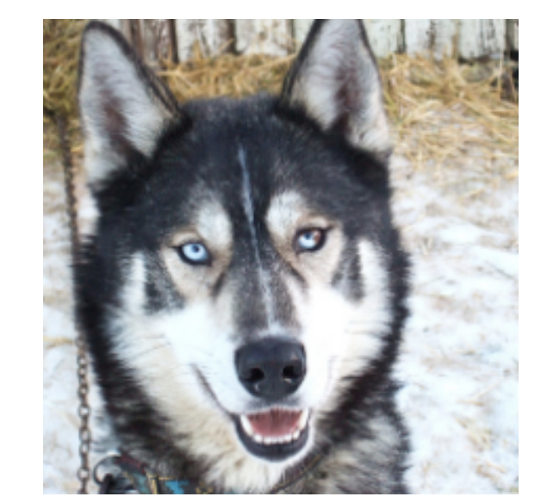
HUSKY classified as WOLF

Slide 8
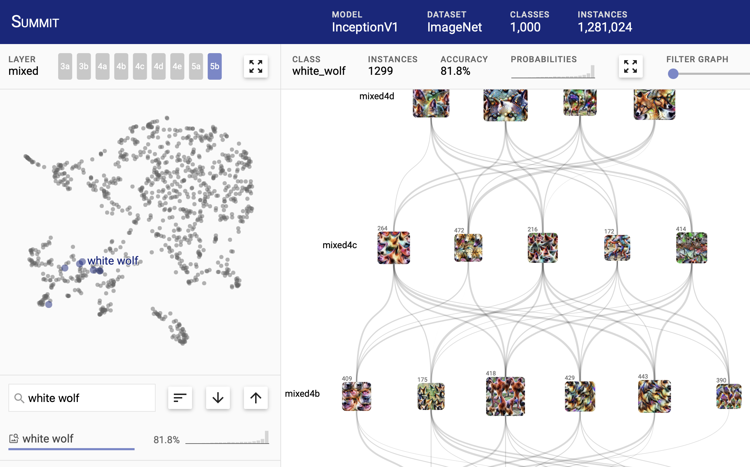
SUMMIT
Interactive visualization that scalably summarizes what features a deep learning model has learned and how those features interact to make predictions.
https://fredhohman.com/summit/

Slide 9
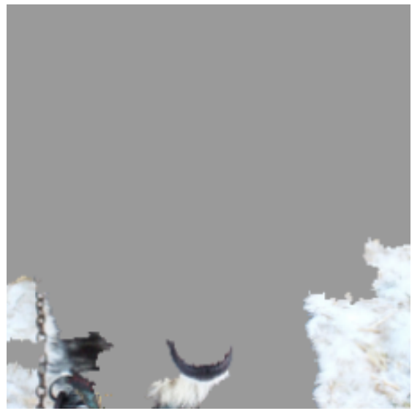
WHY?
Qué lugares de la imagen fueron importantes para hacer la clasificación?
SNOW
Explicability
HUSKY classified as WOLF
Explanation
https://arxiv.org/pdf/1602.04938.pdf

Slide 10
CÓMO ENGAÑAR UNA RED CNN ?

Slide 11
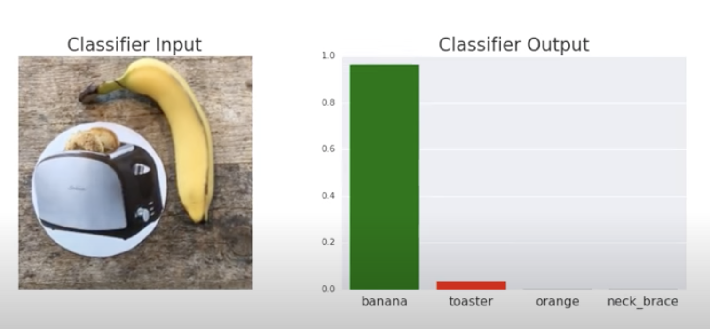
https://youtu.be/i1sp4X57TL4

Slide 12
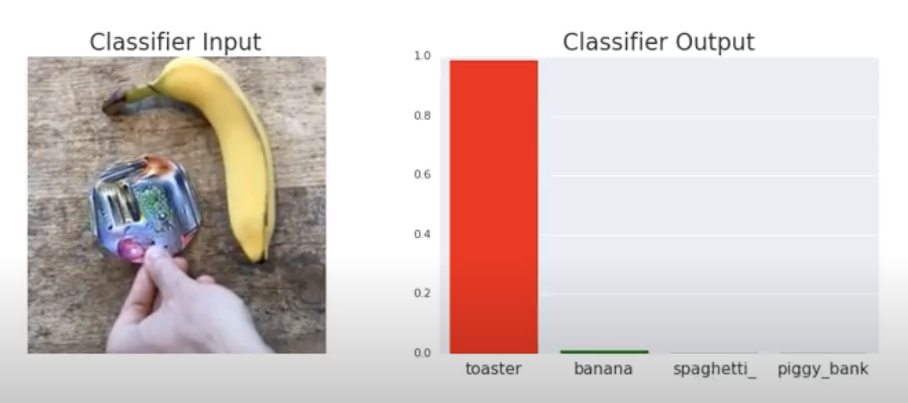
https://youtu.be/i1sp4X57TL4

Slide 13
KINDSHIP DETECTION
The kinship problem is to analyze two face images and detect if the persons have a relation such as parent-child or sibling.

Slide 14
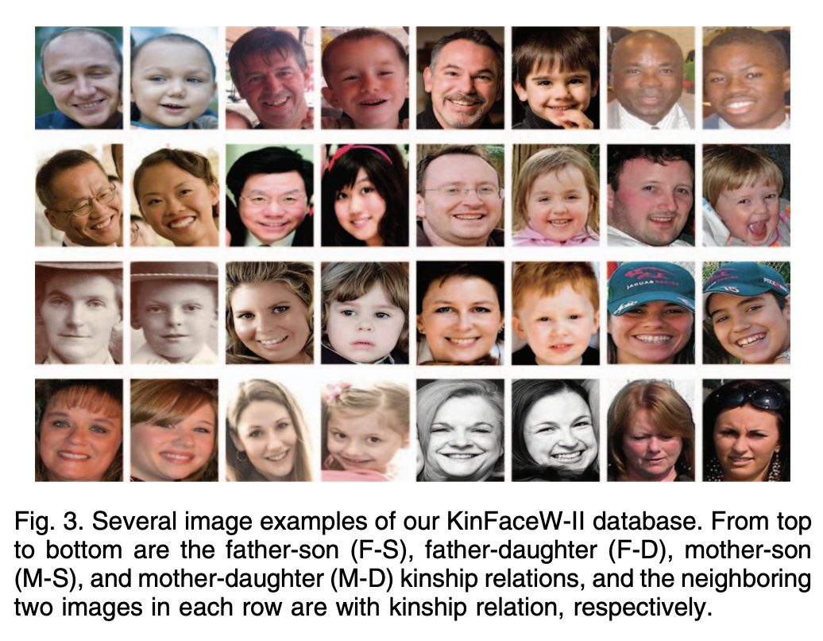
Lu, J., Zhou, X., Tan, Y. P., Shang, Y., & Zhou, J. (2013). Neighborhood repulsed metric learning for kinship verification. IEEE transactions on pattern analysis and machine intelligence, 36(2), 331-345.

Slide 15
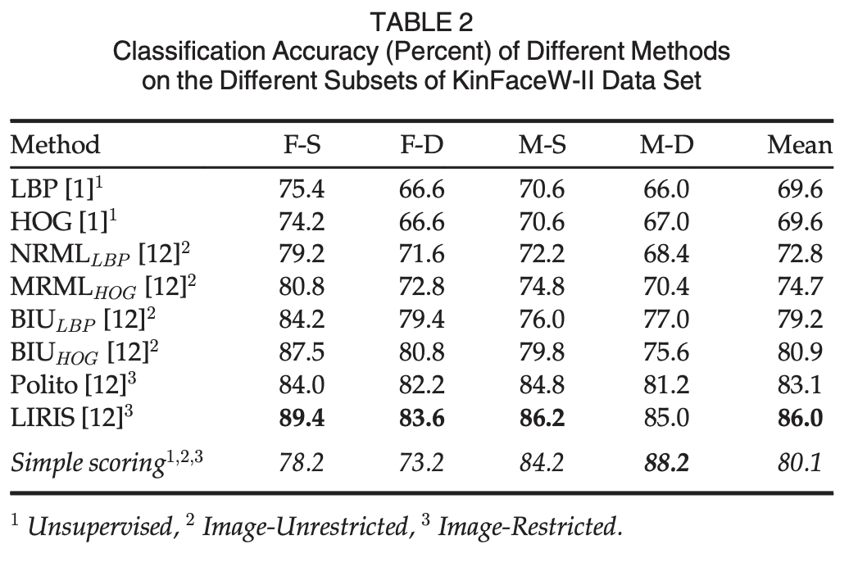
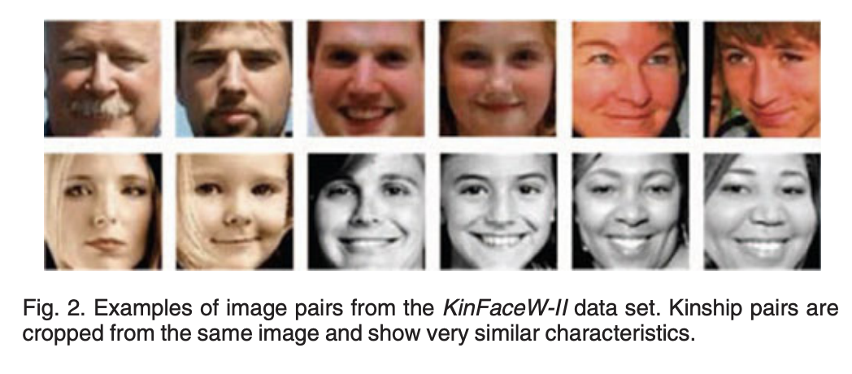
López et al presentaron resultados en los que se comparaban pares de imágenes basándose únicamente en la distancia de crominancia entre ellas (sin ningún tipo de análisis facial), mostrando que la distancia de crominancia obtenía mejores resultados en la detección del parentesco que varios algoritmos publicados.
López, M. B., Boutellaa, E., & Hadid, A. (2016). Comments on the “kinship face in the wild” data sets. IEEE transactions on pattern analysis and machine intelligence, 38(11), 2342-2344.

Slide 16
Explicabilidad
Explainable AI (XAI) tiene como objetivo crear un conjunto de técnicas de Machine Learning que:
Produzcan modelos más explicables, manteniendo un alto nivel de rendimiento de aprendizaje (precisión de predicción); y
Permitan a los usuarios humanos comprender, confiar adecuadamente y gestionar eficazmente la nueva generación de socios artificialmente inteligentes.

Slide 17
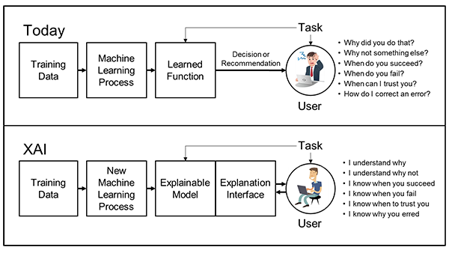
https://www.darpa.mil/program/explainable-artificial-intelligence

Slide 18
https://www.darpa.mil/program/explainable-artificial-intelligence

Slide 19
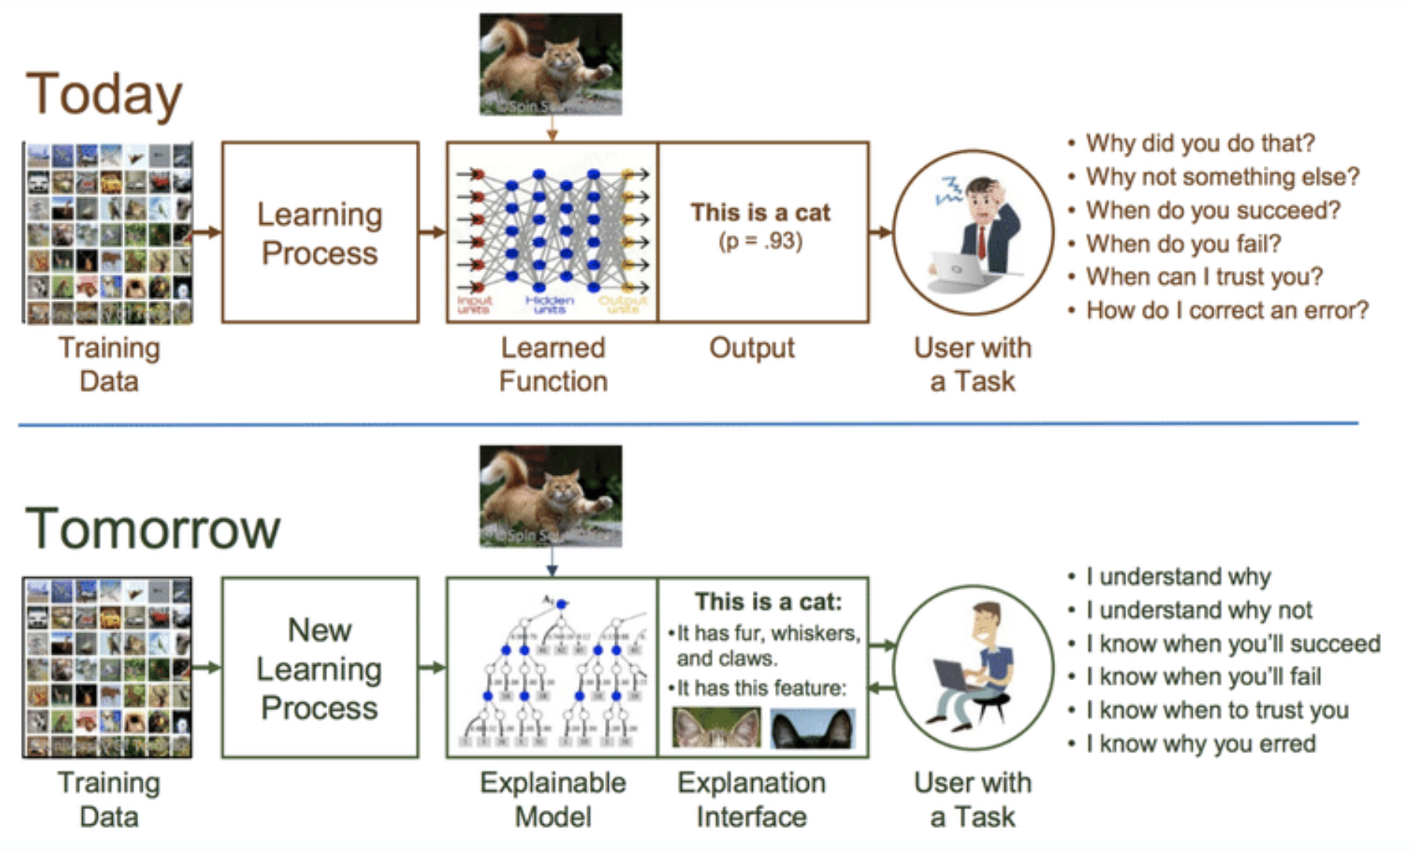
https://www.darpa.mil/program/explainable-artificial-intelligence

Slide 20
https://www.darpa.mil/program/explainable-artificial-intelligence

Slide 21
Por qué explicar?
Si entendemos cómo funciona un algoritmo podemos mejorarlo, podemos controlarlo, podemos descubrir nuevo conocimiento.
Cuando hay temas legales o éticos, es necesario una justificación para explicarle a una persona afectada/beneficiada el por qué de una decisión.
Por último, de esta manera generamos confianza.

Slide 22
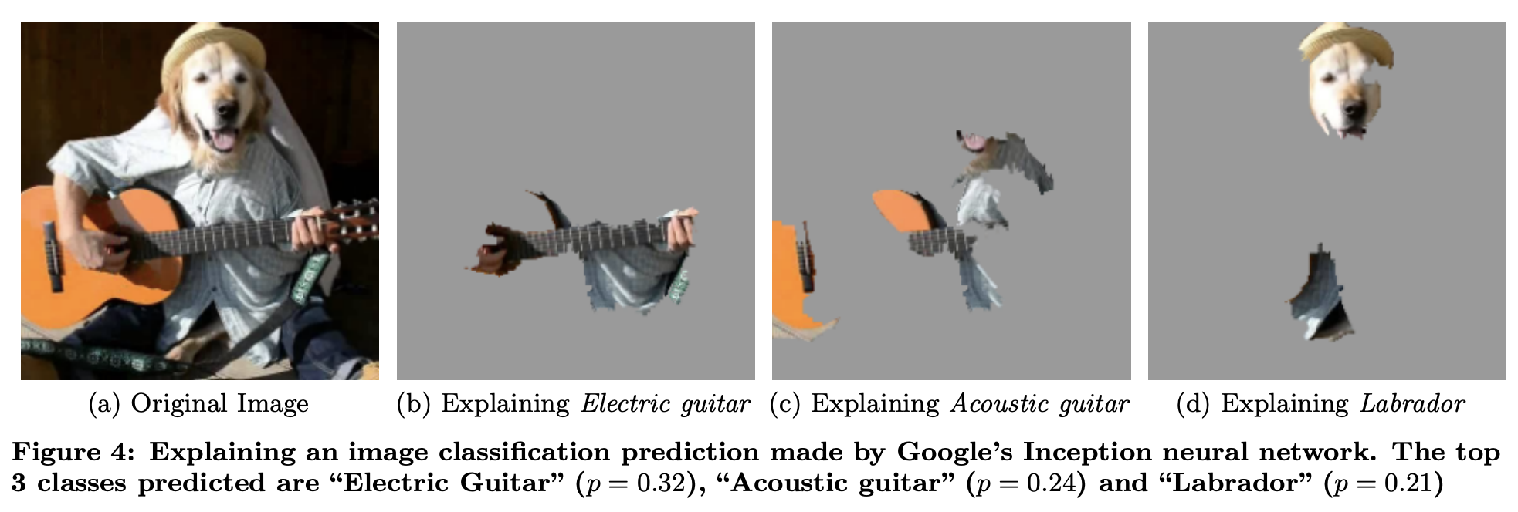
Ejemplo de explicabilidad
https://arxiv.org/pdf/1602.04938.pdf

Slide 23
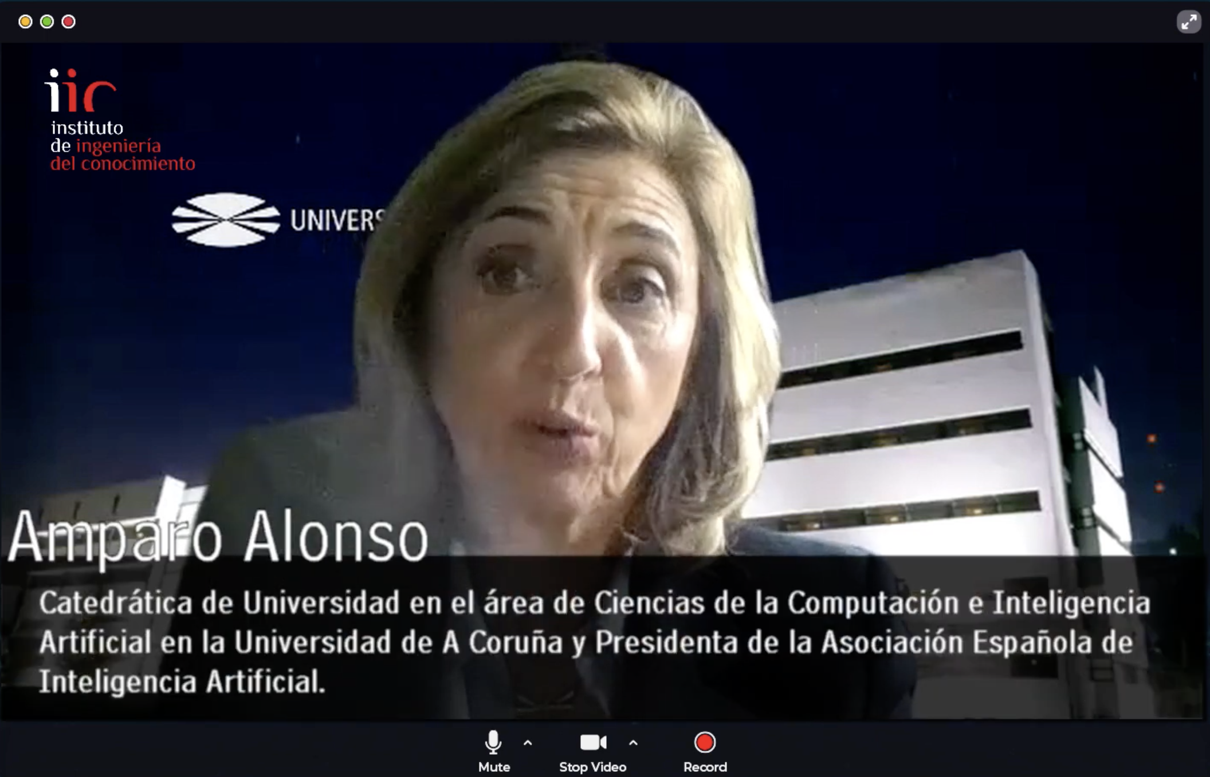
https://youtu.be/lmv367NCW28 > desde 0:24 hasta 4:58

Slide 24
ALGORITMOS DE EXPLICABILIDAD
En visión por computador para Cajas Negras

Slide 25
RISE
Randomized Input Sampling for Explanation
Petsiuk, V., Das, A., & Saenko, K. (2018). Rise: Randomized input sampling for explanation of black-box models. arXiv preprint arXiv:1806.07421.
https://arxiv.org/pdf/1806.07421.pdf

Slide 26
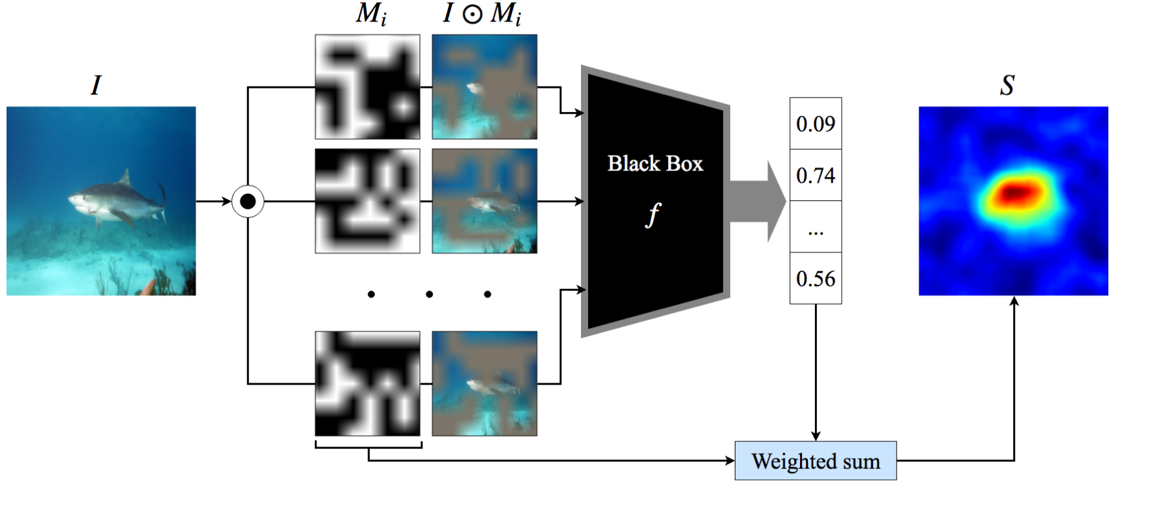
RISE
Petsiuk, V., Das, A., & Saenko, K. (2018). Rise: Randomized input sampling for explanation of black-box models. arXiv preprint arXiv:1806.07421.

Slide 27
RISE
Petsiuk, V., Das, A., & Saenko, K. (2018). Rise: Randomized input sampling for explanation of black-box models. arXiv preprint arXiv:1806.07421.

Slide 28
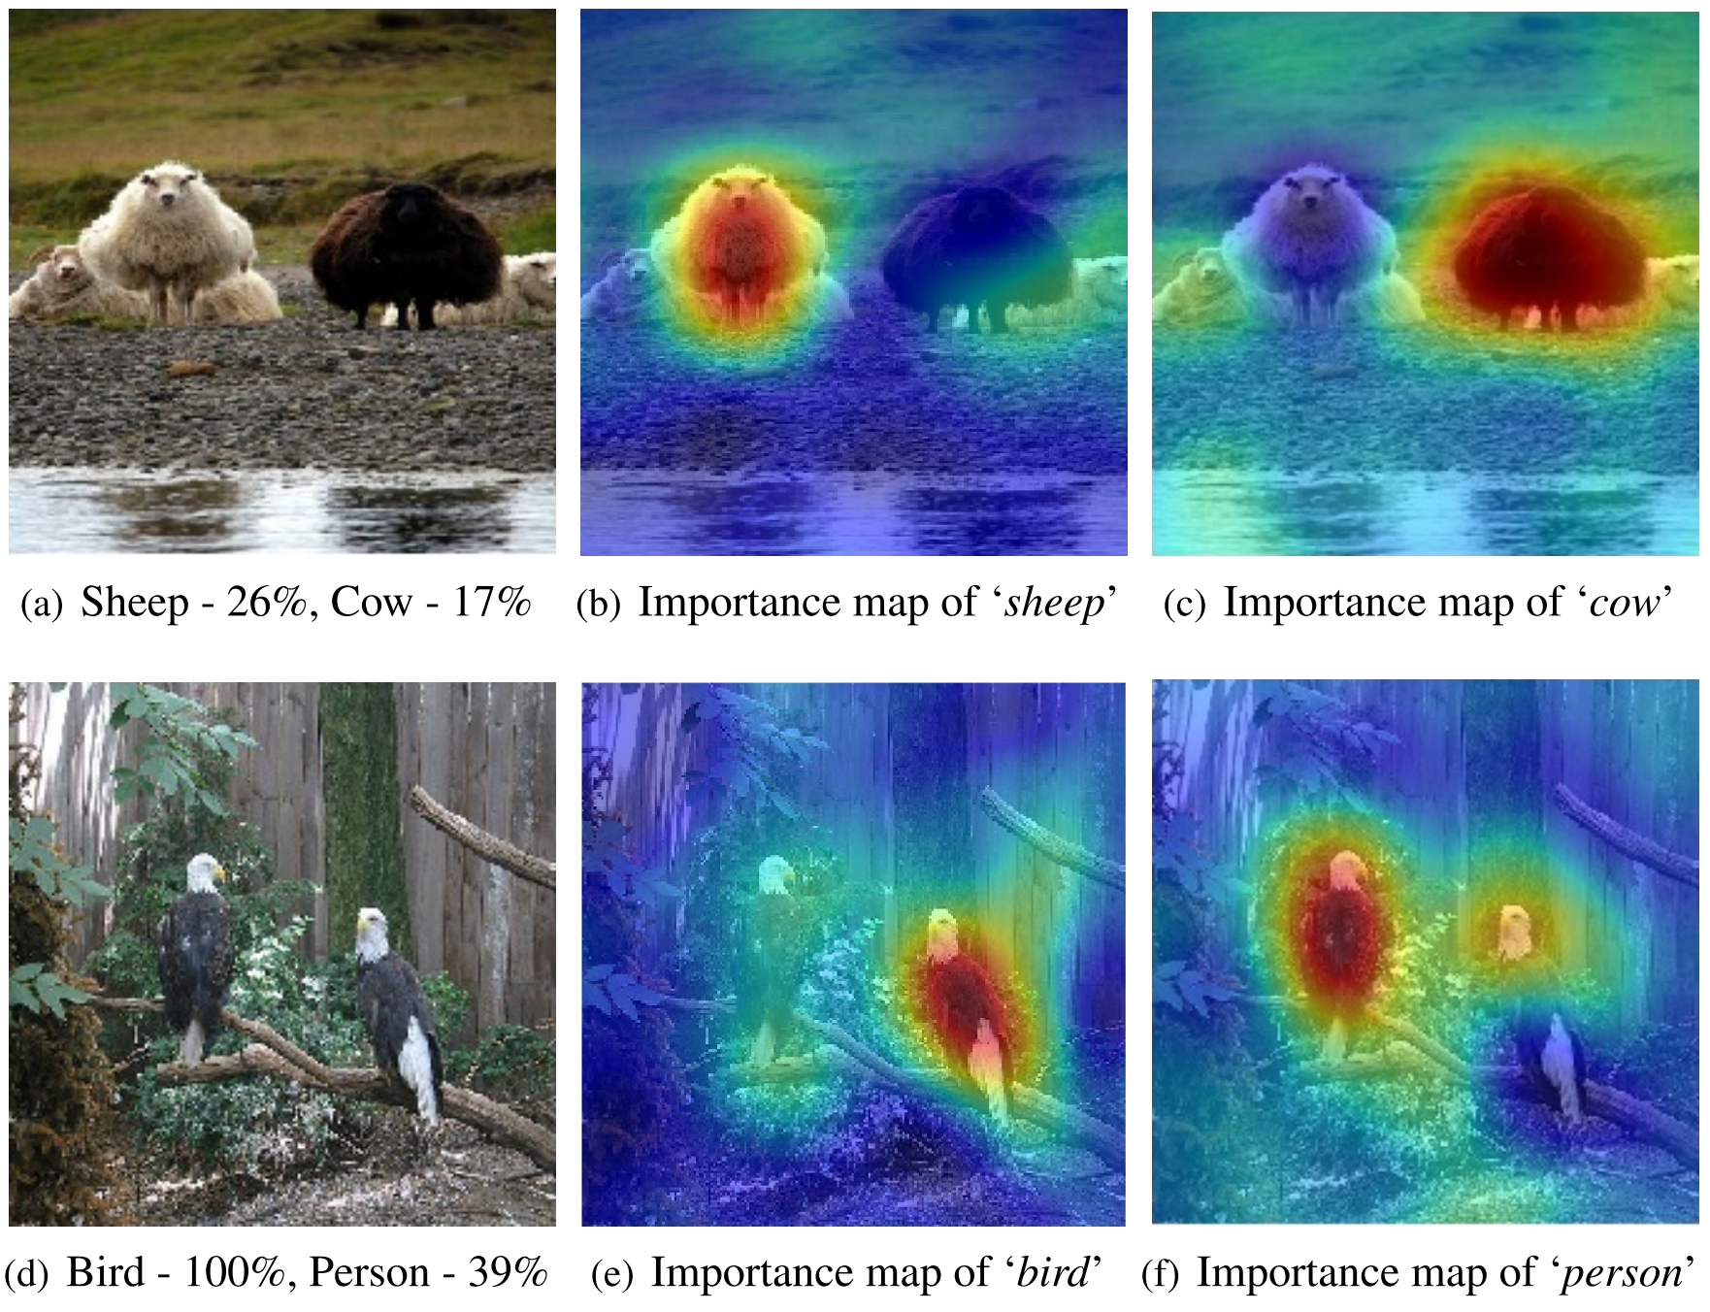
RISE

Slide 29
LIME
Local Interpretable Model-agnostic Explanations
Ribeiro, M. T., Singh, S., & Guestrin, C. (2016, August). " Why should i trust you?" Explaining the predictions of any classifier. In Proceedings of the 22nd ACM SIGKDD international conference on knowledge discovery and data mining (pp. 1135-1144).
https://arxiv.org/pdf/1602.04938.pdf

Slide 30
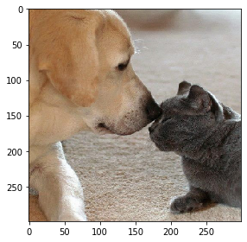
1. Input Image

Slide 31
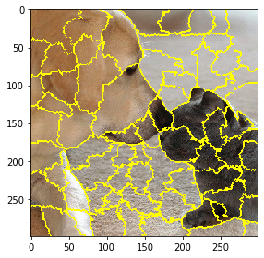
2. Superpixels
(clustering of similar color pixels using quickshift segmentation algorithm)
A. Vedaldi and S. Soatto. Quick shift and kernel methods for mode seeking. In Proc. ECCV, 2008.

Slide 32
3. Labeling
5
1
2
4
6
7
8
(m = 68 superpixels)
3
9
68

Slide 33
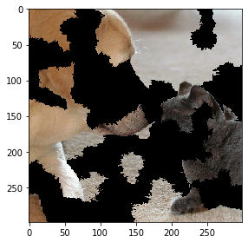
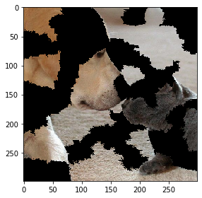
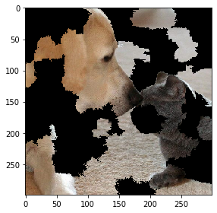
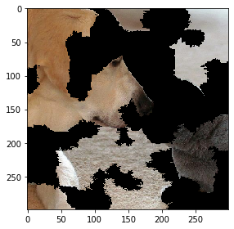
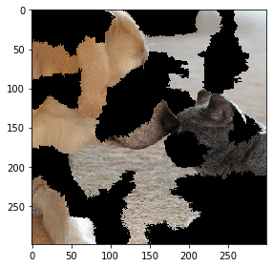
4. Perturbations
(turn on/off each superpixel randomly with p=0.5 n=150 times)
1 2 3 4 150
. . .
[1,0,1,1,…,1]
[1,0,0,1,…,1]
[0,0,1,0,…,1]
[1,1,1,0,…,0]
[0,0,0,1,…,0]
(vectors of m=68 elements)

Slide 34
5. Distances
(similarity between perturbation and original image)
1 2 3 4 150
. . .
[1,0,1,1,…,1]
[1,0,0,1,…,1]
[0,0,1,0,…,1]
[1,1,1,0,…,0]
[0,0,0,1,…,0]
z = [1,1,1,1,…,1]

Slide 35
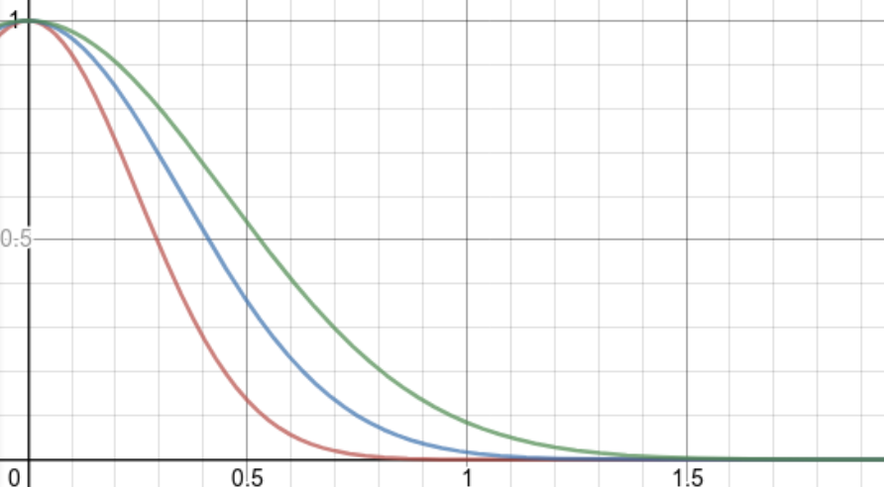
6. Weights
(distances are mapped to a value between zero and one (weight) using a kernel function)

Slide 36
7. Prediction
(probability of classification, probability of being a labrator)
1 2 3 4 150
. . .
f
f
f
f
f

Slide 37
8. Weighted Linear Regression
The magnitude of the coefficients represents how strong is the influence of the corresponding superpixel on the prediction.
n x m
Weighted Linear Regression
n x 1
m x 1
(coefficients)
m: number of superpixels
n: number of perturbations
n x 1
https://towardsdatascience.com/weighted-linear-regression-2ef23b12a6d7

Slide 38
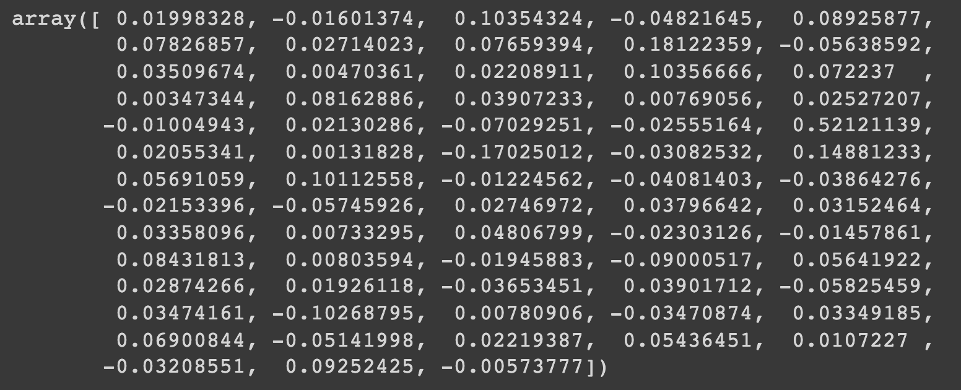
9. Top Features (4)
Superpixels: 9, 14, 25, 30
(select the largest coefficients)
68 x 1 elementos

Slide 39
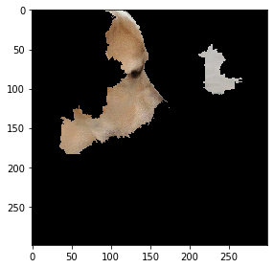
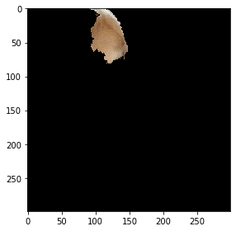
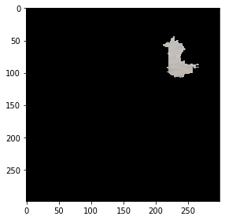
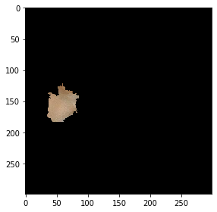
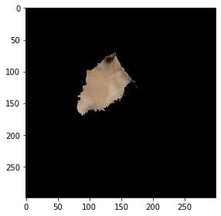
10. Image with selected Superpixels
Superpixels: 9, 14, 25, 30
9 14 25 30
(Superpixels with largest coefficients)
Explanation

Slide 40
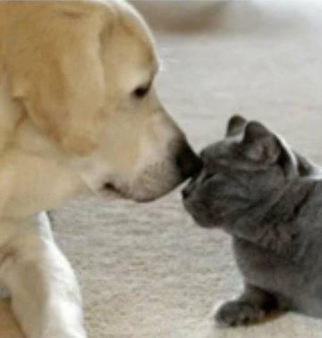
WHY?
Qué lugares de la imagen fueron importantes para hacer la clasificación?
Explicability
Labrador
Explanation
https://arteagac.github.io/blog.html

Slide 41
EXPLICABILIDAD EN FACE VERIFICATION

Slide 42

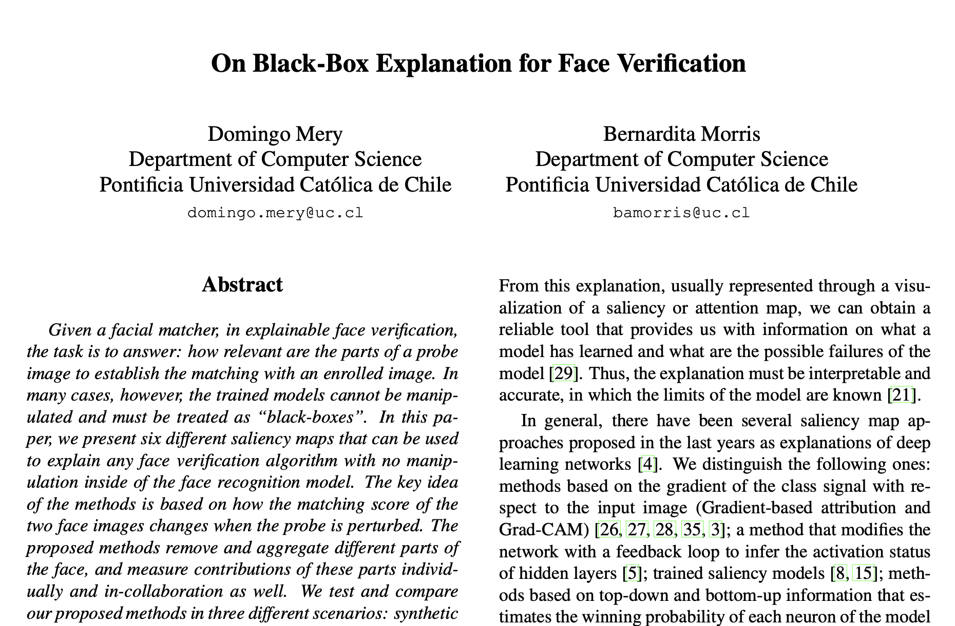
IEEE Winter Conference on Applications of Computer Vision
https://github.com/domingomery/vision/blob/master/clases/Cap03_DeepLearning/papers/2022-BlackBoxExplanationFaceVerification.pdf

Slide 43
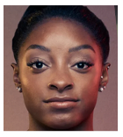
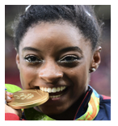
Face Verification
Facial
Matcher
enrolled
image
Same
Person
(score > t)
probe
image

Slide 44
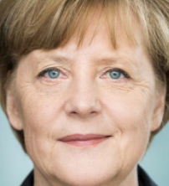
Face Verification
Facial
Matcher
enrolled
image
Different
Persons
(score < t)
[ BLACK BOX ]
probe
image

Slide 45
Motivation
Facial matcher models are very effective, but it is not known what they do internally, sacrificing interpretability for accuracy.
Explainable face verification arises from the need to understand the facial matcher models.
This methodology can help us, humans, to interpret and visualize the models that are often considered as black-boxes.
In explainable face verification, the task is to answer how relevant are the parts of a probe image to establish the matching with an enrolled image.

Slide 46
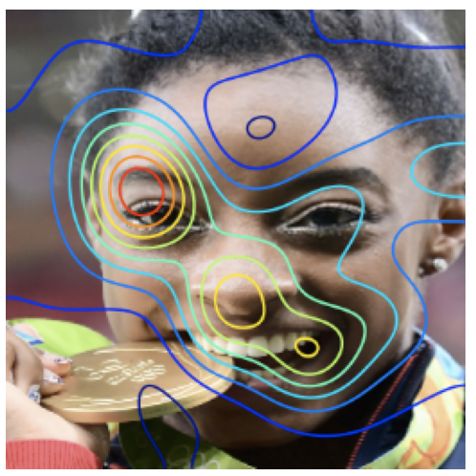
Black-Box Explanation for Face Verification
Processing
enrolled
image
Facial
Matcher
Analysis
saliency map
probe
image

Slide 47
Face Verification
Facial
Matcher
enrolled
image
score
1.0000
probe
image

Slide 48
Face Verification
Facial
Matcher
enrolled
image
score
0.5699
probe
image

Slide 49
Face Verification
Facial
Matcher
enrolled
image
score
0.4226
probe
image

Slide 50
Face Verification
Facial
Matcher
enrolled
image
score
0.5699
probe
image

Slide 51
Face Verification
Facial
Matcher
enrolled
image
score
0.5643
probe
image

Slide 52
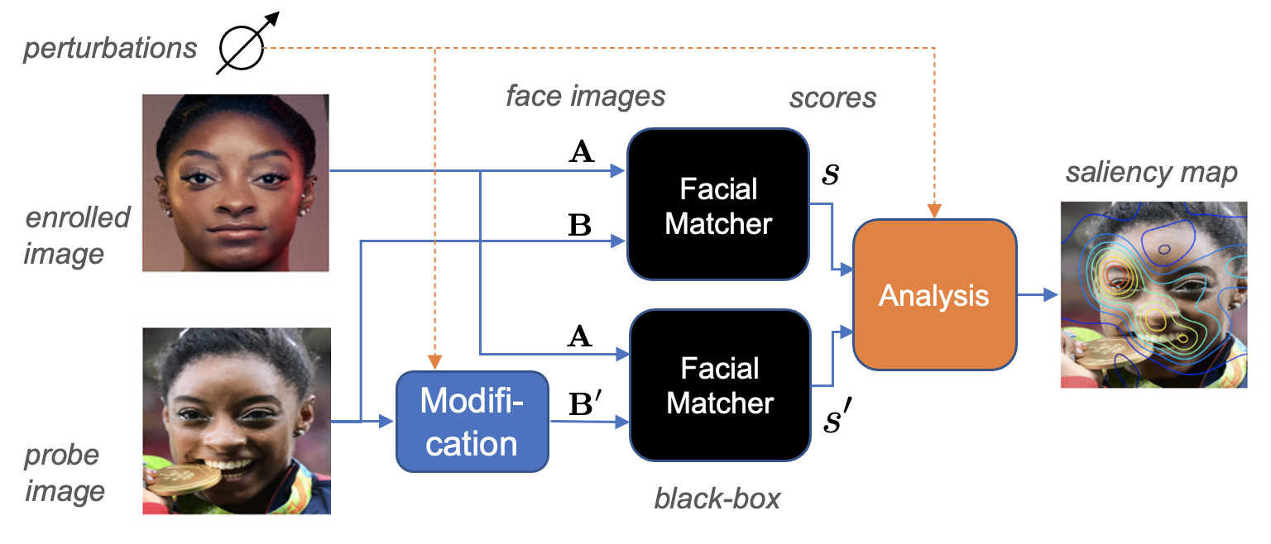
Proposed Method

Slide 53
EXPLICABILIDAD EN FACE VERIFICATION
Algoritmo Removal

Slide 54
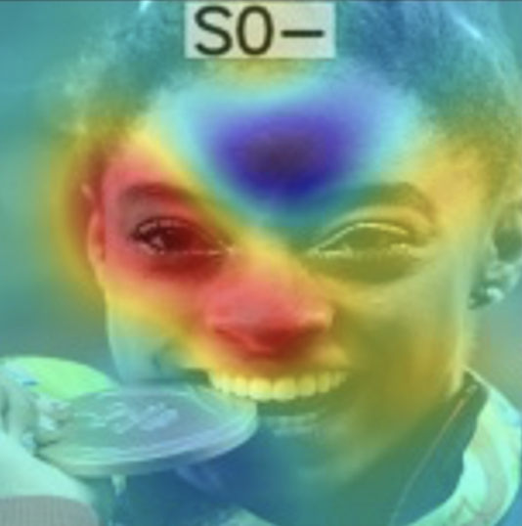
Removal
Facial
Matcher
enrolled
image
score by removing
one region
probe
image

Slide 55
Removal
Facial
Matcher
enrolled
image
probe
image

Slide 56
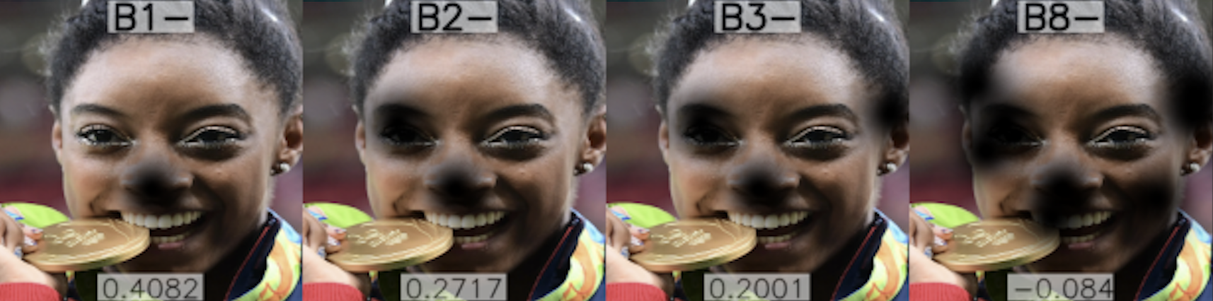
Removal
Facial
Matcher
enrolled
image
probe
image

Slide 57
Removal
Facial
Matcher
enrolled
image
probe
image

Slide 58
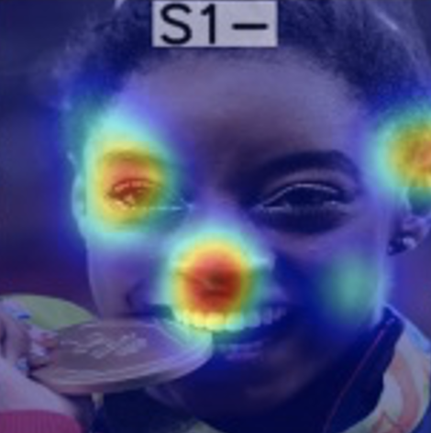
Removal
Facial
Matcher
enrolled
image
score by removing
one region after another
probe
image

Slide 59
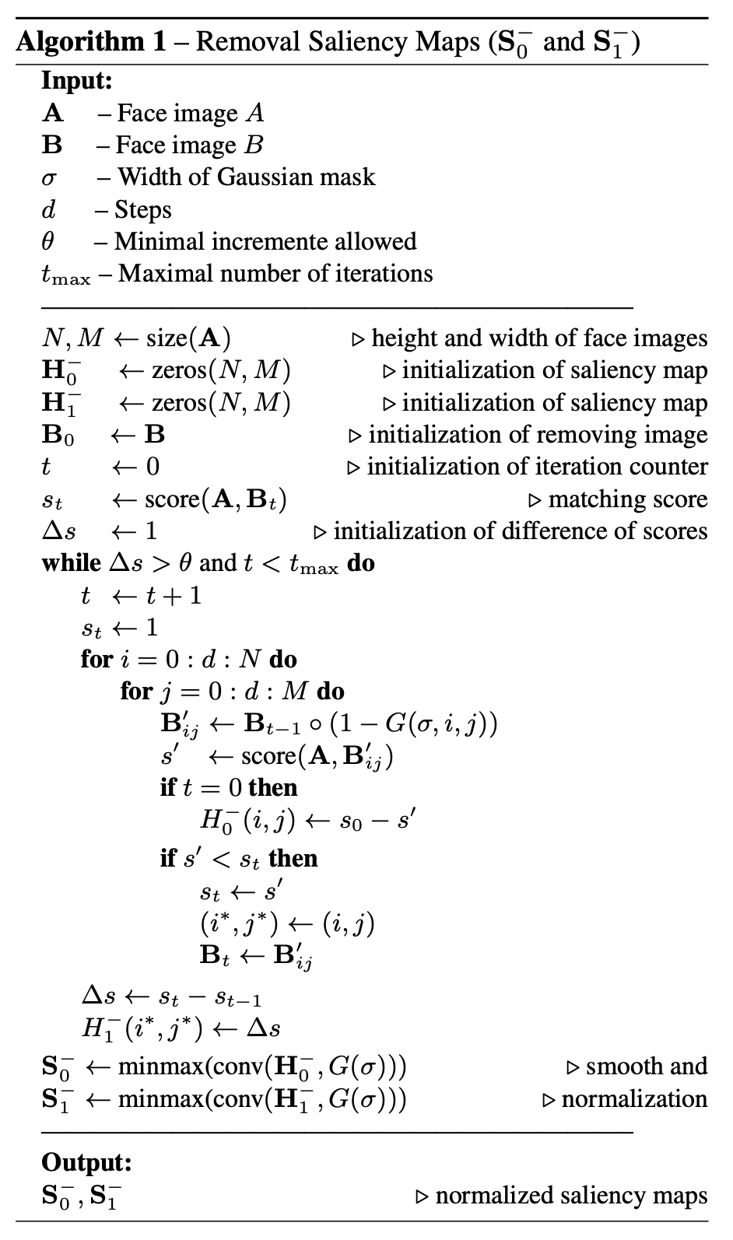

Slide 60
EXPLICABILIDAD EN FACE VERIFICATION
Algoritmo Aggregation

Slide 61
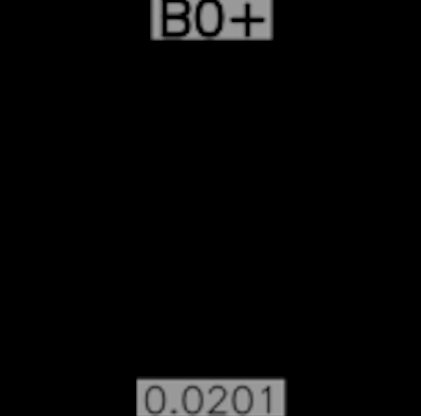
Aggregation
Facial
Matcher
enrolled
image
probe
image

Slide 62
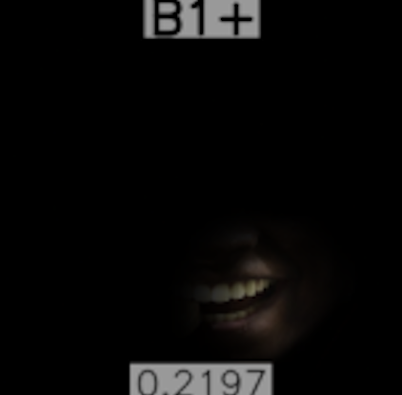
Aggregation
Facial
Matcher
enrolled
image
probe
image

Slide 63
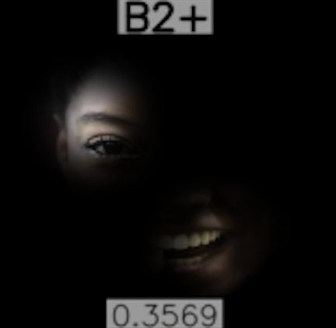
Aggregation
Facial
Matcher
enrolled
image
probe
image

Slide 64
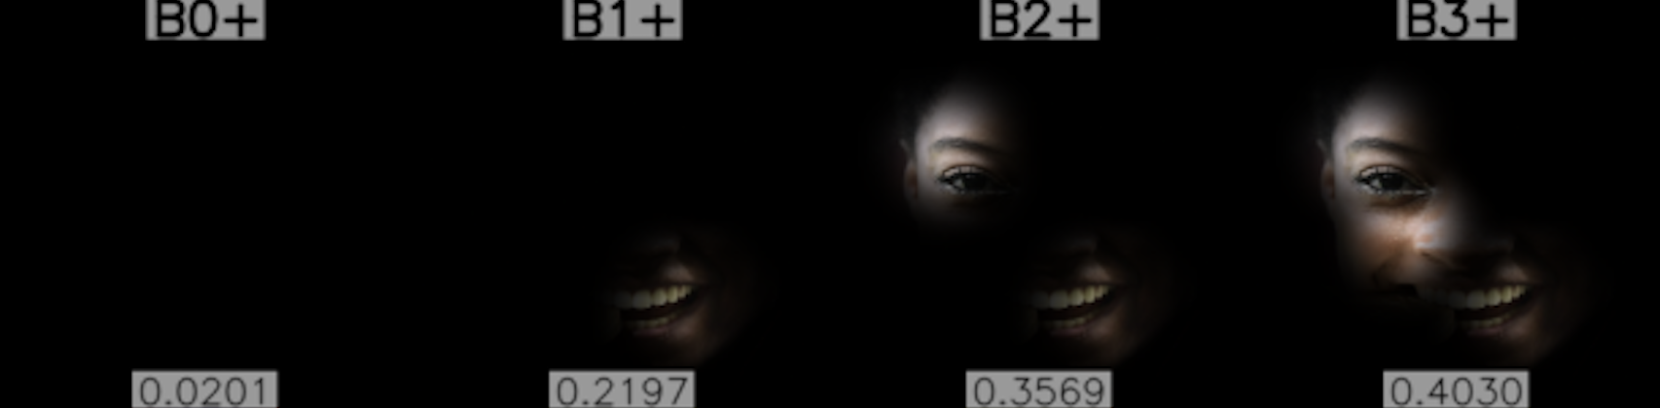
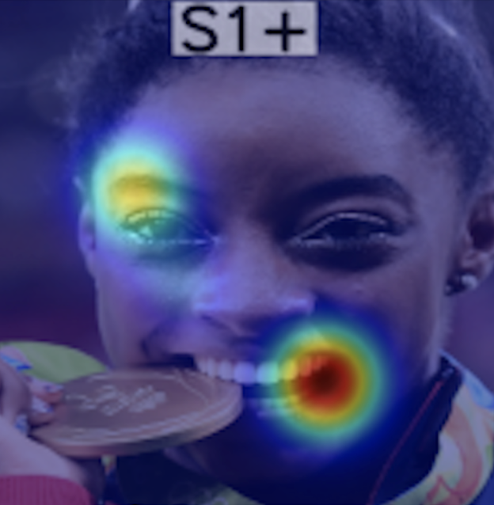
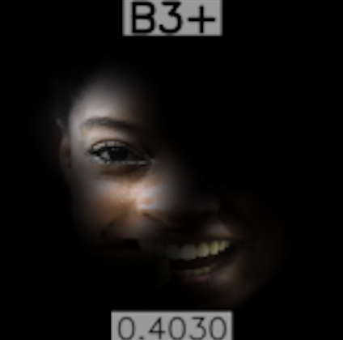
Aggregation
Facial
Matcher
enrolled
image
score by adding
one region after another
probe
image

Slide 65
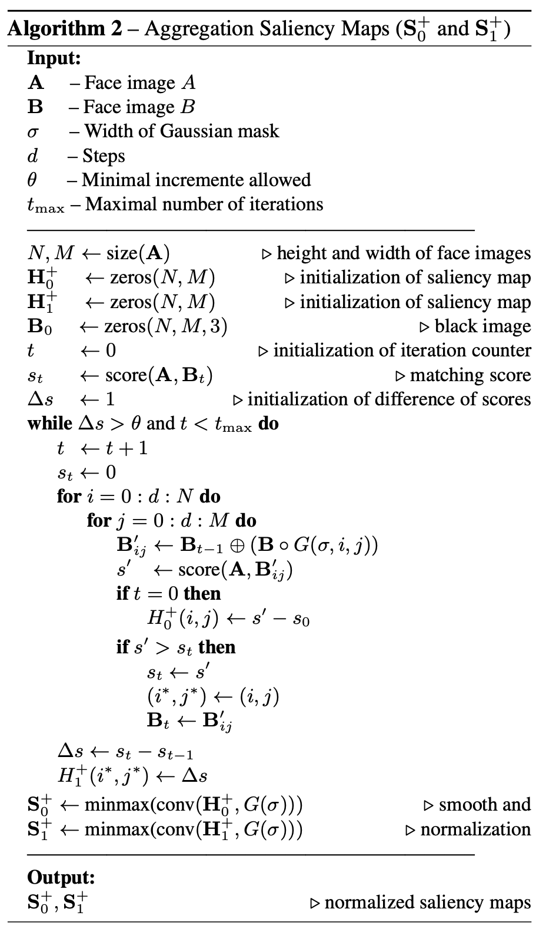

Slide 66
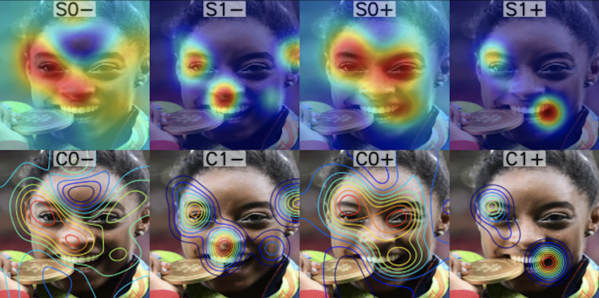
Saliency Maps
score by removing
one region
score by removing
one region after another
score by adding
one region
score by adding
one region after another

Slide 67
Saliency Maps & Contour Lines
Combination

Slide 68

Combination of Saliency Maps

Slide 69
Experiments
In our experiments, five different face verification algorithms are used (ArcFace, Dlib, VGGface2, CasiaWebFace, LBP).
We test and compare our proposed methods in three different scenarios:
synthetic images with different qualities and occlusions,
real face images with different facial expressions, poses, and occlusions and
faces from different demographic groups.

Slide 70


1.
Synthetic images with different qualities and occlusions
OURS

Slide 71

2.
Real face images with different facial expressions, poses, and occlusions

Slide 72
2.
Real face images with different facial expressions, poses, and occlusions

Slide 73

3.
Faces from different demographic groups

Slide 74
Conclusions
We propose six different approaches to build saliency maps avoiding any manipulation inside of the face recognition model.
Our methods remove and aggregate relevant parts of the face, and measure individual contributions of these parts and in collaboration as well.
Using this method, we appreciate which are the most relevant face areas that an algorithm considers to carry out the recognition.
Our approach can be used to evaluate commercial off-the-shelf face recognition systems as well.

Slide 75

Google Colab:
https://domingomery.ing.puc.cl/material/

